Slide 1
OBOB 2022/2023
3-5 Grade Division

Slide 2
What is OBOB?
OBOB stands for Oregon Battle of the Books!
The Battle of the Books is a friendly reading competition. You will get into teams of 4-5 students and read a list of 16 books. You do NOT have to read all 16 unless you want to! I suggest reading about 4 or 5 of the books. To battle, your team will compete against one other team answering questions about the books from the list. Let’s take a look at the books!!

Slide 3
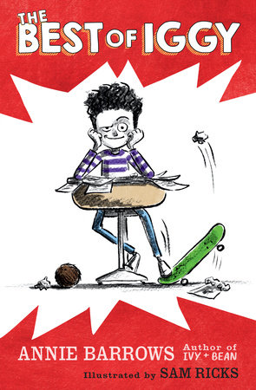
The best of iggy
by annie barrows
Meet Iggy Frangi. He's not a bad kid, he's really not. Okay, so he's done a few (a few is anything up to 100) bad things. And okay, he's not very sorry about most of them. People make a big deal about nothing. What's a little pancake here and there? Is that something to get mad about? Iggy doesn't think so. No one got hurt, so there's no problem. No one got hurt except for that one time, that one time when the Best Idea Ever turned into the Worst Idea of All Time.

Slide 4
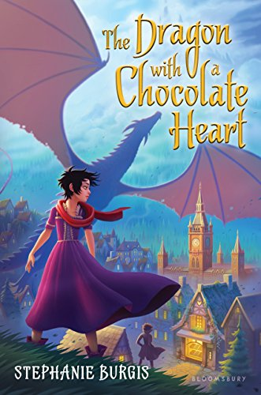
The dragon with a chocolate heart
by stephanie burgess
Restless in her family’s cavern and tired of disappointing the mother who urges her to follow her passion, whatever that might be, a young dragon named Aventurine runs away. She hasn’t traveled far when a mage gives her a cup of hot chocolate that turns her into a human girl, an appalling turn of events. Still, she suddenly realizes her true passion: chocolate. She takes a position as a chocolatier’s apprentice in nearby Drachenburg, but when the dragons take to the skies, and the king’s ministers advise war against them, only Aventurine can save the townsfolk from her family’s fiery wrath.

Slide 5
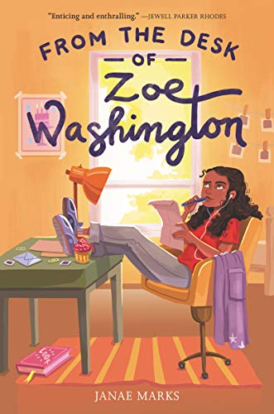
This exceptionally sweet debut shows the real cracks in the American criminal justice system while telling an affecting story grounded in the middle-grade experience.
Zoe Washington, a soon-to-be seventh-grader growing up outside Boston, is celebrating a birthday bereft of friends due to distance and betrayal, when a surprise letter from her incarcerated father arrives and throws her life into emotional disarray.
The secret correspondence they strike up, letters and a few phone calls facilitated by her maternal grandmother, has to be kept a secret from her mother, especially once Zoe decides to investigate whether her father is truly guilty of the dreadful crime that sent him to prison before she was born.
From the desk of zoe washington by janae marks

Slide 6
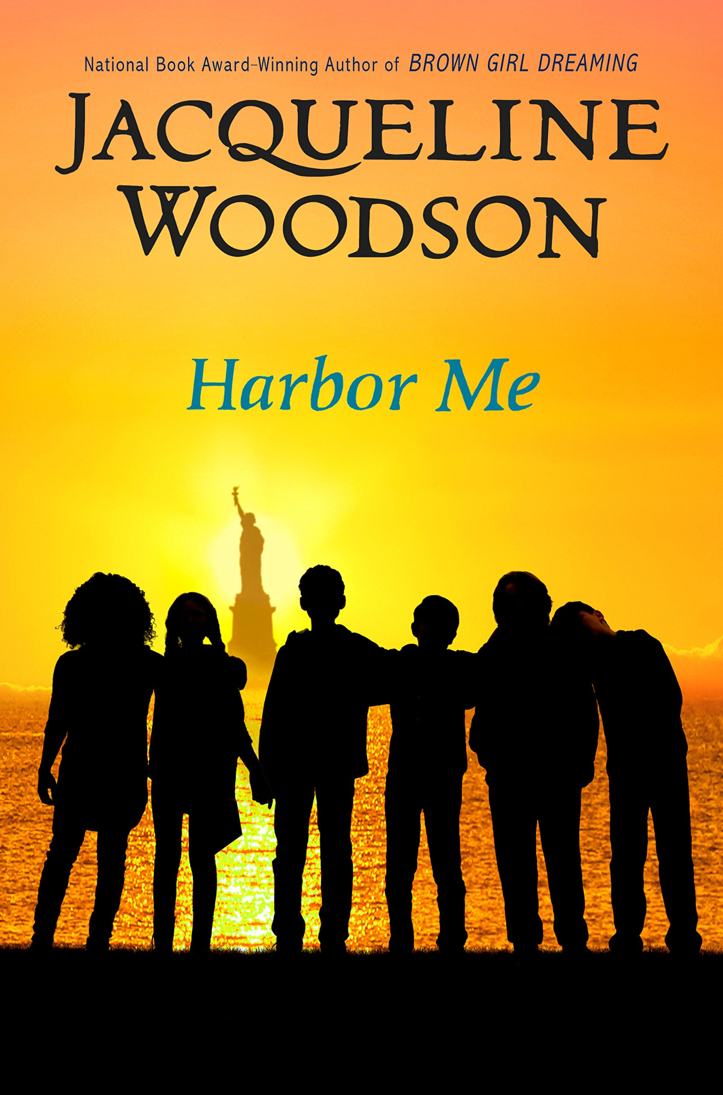
Harbor me
By jacqueline woodson
t all starts when six kids have to meet for a weekly chat--by themselves, with no adults to listen in.
There, in the room they soon dub the ARTT Room (short for "A Room to Talk"), they discover it's safe to talk about what's bothering them--everything from Esteban's father's deportation and Haley's father's incarceration to Amari's fears of racial profiling and Ashton's adjustment to his changing family fortunes.
When the six are together, they can express the feelings and fears they have to hide from the rest of the world. And together, they can grow braver and more ready for the rest of their lives.

Slide 7
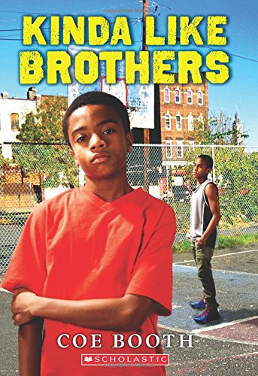
Kinda like brothers
By coe booth
Eleven-year-old Jarrett is used to having foster babies in the house. Then case workers bring 12-year-old Kevon and Kevon’s baby sister, Treasure, and Jarrett feels nothing but resentment about sharing his room with the new boy.
Between his asthma attacks and difficulty passing summer school, Jarrett has enough to worry about without Kevon in his business.
But as Jarrett learns why Kevon and Treasure are in foster care, he starts to see things in a different light.

Slide 8
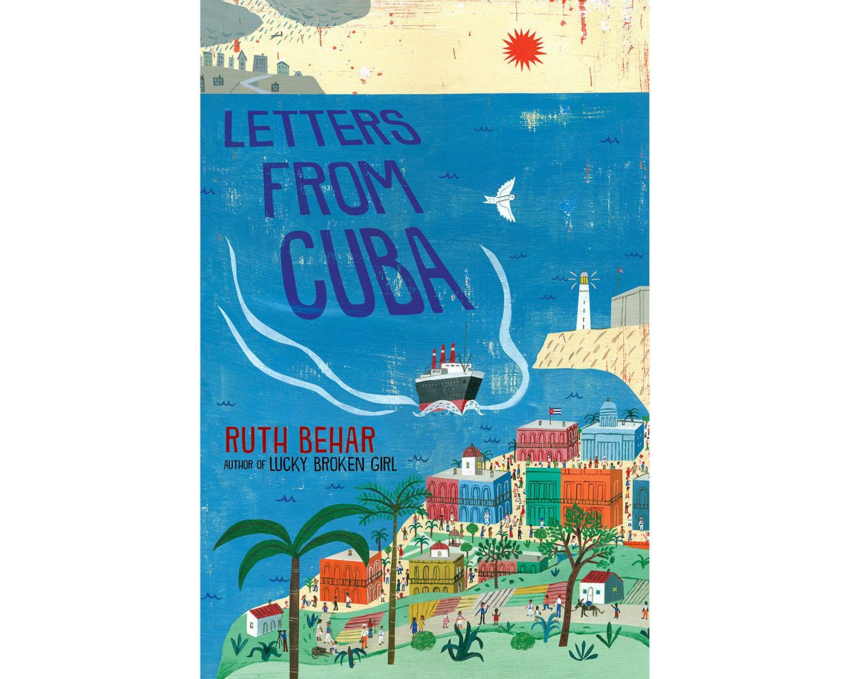
Letters from cuba
by ruth behar
In 1938, eleven-year-old Jewish girl Esther is the first of her siblings to emigrate from Poland to Cuba, joining her father, who went three years earlier. Her letters to her sister, kept in a notebook to be shared later, form the narrative of Esther's new life in Cuba. With the help of her skill as a clothing designer, Esther and Papa save money to bring the rest of the family over, as rumors build of the worsening situation for Jews in Europe.

Slide 9
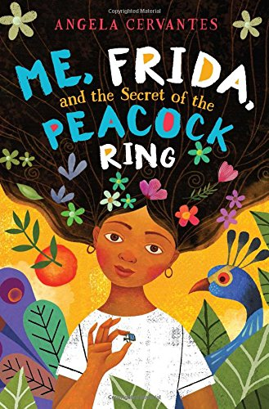
Me, frida, and the secret of the peacock ring
by angela cervantes
Paloma Marquez is traveling to Mexico City, birthplace of her deceased father, for the very first time. She's hoping that spending time in Mexico will help her unlock memories of the too-brief time they spent together.
While in Mexico, Paloma meets Lizzie and Gael, who present her with an irresistible challenge: The siblings want her to help them find a valuable ring that once belonged to beloved Mexican artist Frida Kahlo. Finding the ring means a big reward -- and the thanks of all Mexico.
What better way to honor her father than returning a priceless piece of jewelry that once belonged to his favorite artist!

Slide 10
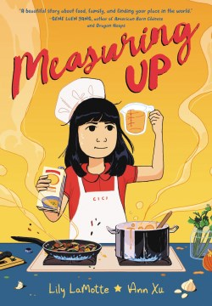
Measuring up
By lilly lamotte & ann xu
Twelve-year-old Cici has just moved from Taiwan to Seattle, and the only thing she wants more than to fit in at her new school is to celebrate her grandmother, A-ma’s 70th birthday together. Since she can’t go to A-ma, Cici cooks up a plan to bring A-ma to her by winning the grand prize in a kids cooking contest to pay for A-ma’s plane ticket! There’s just one problem: Cici only knows how to cook Taiwanese food. And after her pickled cucumber debacle at lunch, she’s determined to channel her inner Julia Child. Can Cici find a winning recipe to reunite with A-ma, a way to fit in with her new friends, and somehow find herself too?

Slide 11
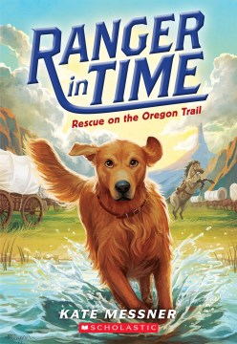
Rescue on the oregon trail
by kate messner
Ranger has been trained as a search-and-rescue dog, but can't officially pass the test because he's always getting distracted by squirrels during exercises. One day, he finds a mysterious first aid kit in the garden and is transported to the year 1850, where he meets a young boy named Sam Abbott. Sam's family is migrating west on the Oregon Trail, and soon after Ranger arrives, he helps the boy save his little sister. Ranger thinks his job is done, but the Oregon Trail can be dangerous, and the Abbotts need Ranger's help more than they realize!

Slide 12
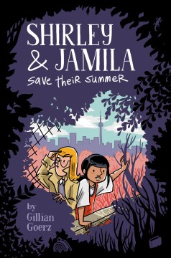
Shirley & jamila save their summer
By gilliam goerz
Jamila Waheed is staring down a lonely summer in a new neighborhood--until she meets Shirley Bones. Sure, Shirley's a little strange, but both girls need a new plan for the summer, and they might as well become friends.
Then this kid Oliver shows up begging for Shirley's help. His pet gecko has disappeared, and he's sure it was stolen That's when Jamila discovers Shirley's secret: She's the neighborhood's best kid detective, and she's on the case. When Jamila discovers she's got some detective skills of her own, a crime-solving partnership is born.
The mystery of the missing gecko turns Shirley and Jamila's summer upside down. And when their partnership hits a rough patch, they have to work together to solve the greatest mystery of all: What it means to be a friend.

Slide 13
Small steps: the year i got polio
By peg kehret
Peg Kehret was stricken with polio when she was twelve years old. At first paralyzed and terrified, she fought her way to recovery, aided by doctors and therapists, a loving family, supportive roommates fighting their own battles with the disease, and plenty of grit and luck. With the humor and suspense that are her trademarks, acclaimed author Peg Kehret vividly recreates the true story of her year of heartbreak and triumph.

Slide 14
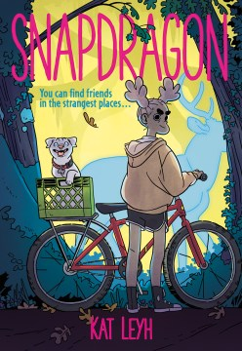
snapdragon
by kat leyh
Kat Leyh's Snapdragon is a magical realist graphic novel about a young girl who befriends her town’s witch and discovers the strange magic within herself. Snap's town had a witch. At least, that’s how the rumor goes. But in reality, Jacks is just a crocks-wearing, internet-savvy old lady who sells roadkill skeletons online—after doing a little ritual to put their spirits to rest. It’s creepy, sure, but Snap thinks it’s kind of cool, too. They make a deal: Jacks will teach Snap how to take care of the baby opossums that Snap rescued, and Snap will help Jacks with her work. But as Snap starts to get to know Jacks, she realizes that Jacks may in fact have real magic—and a connection with Snap’s family’s past.

Slide 15
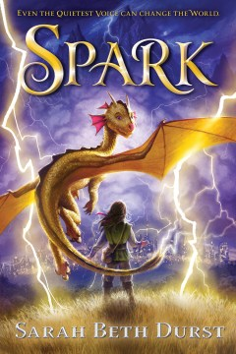
spark
by sarah beth durst
Alorria is a perfect land of sunshine, gentle rain, and breezes whenever needed, as its weather is controlled by storm beasts and their guardians. Here, quiet Mina and her family live. Things for Mina are about to change drastically, as her storm-egg hatches after two years to reveal that her storm beast, Pixit, is a lightning beast. Her family thinks there’s been a mistake; how can Mina, with her quiet, gentle nature, control a lightning beast? But off she and Pixit go to Mytris Lightning School in the Northwest Barrens. Frightened and excited, Mina wants terribly to succeed with Pixit, although mishaps seem to constantly beset them. When they fly off course in a practice storm, both are injured and cared for by people across the mountains whom Mina didn’t know existed. This leads to the pair’s life mission: to make the people of Alorria understand their perfect world is creating chaos for the rest of the world.

Slide 16
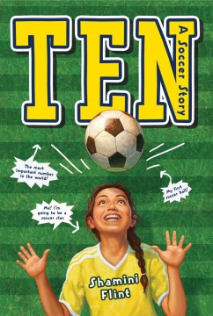
Ten
By shamini flint
Ten-year-old Maya believes she’s found her calling. She’s going to be a professional soccer star (never mind that she’s never even kicked a ball) or at least marry one! However, the odds are stacked against her. She lives in a conservative seaside town in Malaysia. She’s born to a mother of Indian descent and a white English father, solidifying her status as a misfit. And her grandmother is always harping on her to be a good Indian girl—and good Indian girls don’t play soccer. Although her schoolmates at her all-girls convent school reject soccer as a boy’s sport, Maya perseveres and eventually recruits enough players to make a team. However, she realizes that playing soccer is the least of her problems.

Slide 17
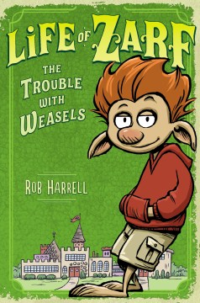
The trouble with weasels by rob harrell
It's not easy being Zarf. As a troll, he's stuck at the bottom of the middle school hierarchy, way below the prince and knights (populars), ogres and giants (jocks), and even the lowly minstrels (band geeks). Plus, trolls aren't exactly known for their brain power or cool demeanor. But it gets worse. When the king disappears and Zarf's archenemy, the prince, ascends the throne, he makes Zarf's life even more miserable. And so it is that Zarf and his two sidekicks (a neurotic, mutton-obsessed pig and the not-funny son of the court jester) set out to find the missing king as well as their way to middle school heroism. (Okay, the heroism part might be wishful thinking.)

Slide 18
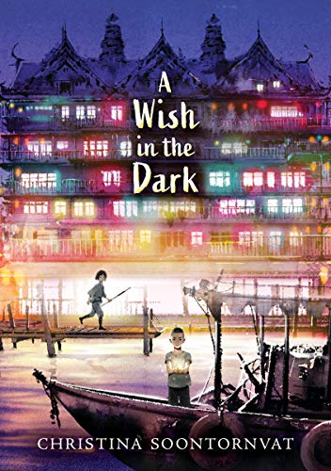
A wish in the dark By christina soontornvat
Years ago, the city of Chattana burned to the ground in a Great Fire and was thrown into chaos. The Governor restored peace to the city and powered it magically with orbs that gave light, heat, and power.
Pong was born in Namwon Prison. Those lights represent freedom; but when he escapes from prison, he learns that the Governor controls who is in light and who is in darkness. In this society, everyone is beholden to the Governor and no one is truly free.
Nok's father, born into society and now the prison warden, is disgraced when the 12-year-old Pong escapes. Unable to bear her father's shame, Nok embarks on a quest to find Pong and avenge her father's reputation.

